Slide 1
DBMS I IA REVIEW
Jayanthi M.G

Slide 2
Contents
Relational Algebra
Basic SQL queries
ER diagram
ER mapping

Slide 3
Consider the following relational database schema for a college management system:
STUDENT (Student_ID, Name, Department, Semester)
COURSE (Course_ID, Course_Name, Department)
ENROLLMENT (Student_ID, Course_ID, Marks)
Write relational algebra expressions for the following queries:
Retrieve the names of students belonging to the CSE department. (2 Marks)
Find the names of students who have enrolled in the course 'Database Management Systems'. (3 Marks)
Retrieve the names of students who scored more than 80 marks in any course. (2 Marks)
Find the names of students who have enrolled in courses offered by the CSE department. (3 Marks)

Slide 4
Consider the relations:
CUSTOMER (Cust_ID, Cust_Name, City)
ACCOUNT (Acc_No, Cust_ID, Balance, Branch_ID)
BRANCH (Branch_ID, Branch_Name, City)
Write relational algebra expressions to:
Find customers residing in Bengaluru. (2M)
Retrieve the names of customers having an account balance greater than ₹1,00,000. (3M)
Find the names of customers who hold an account at a branch located in Mysuru. (3M)
Retrieve the IDs of customers who do not hold any account. (2M)

Slide 5
Consider the relations:
MEMBER (Member_ID, Name, Department)
BOOK (Book_ID, Title, Author, Publisher)
ISSUE (Member_ID, Book_ID, Issue_Date, Return_Date)
Write relational algebra expressions to:
Find the titles of books written by a particular author, 'Chetan Bhagat'. (2M)
Retrieve the names of members who have borrowed books. (3M)
Find the names of members who borrowed books published by 'Pearson'. (3M)
Retrieve the book IDs of books that have never been issued. (2M)

Slide 6
Consider the relations:
EMPLOYEE (Emp_ID, Emp_Name, Dept_ID, Salary)
DEPARTMENT (Dept_ID, Dept_Name, Location)
PROJECT (Project_ID, Project_Name, Dept_ID)
Write relational algebra expressions to:
Find employees earning a salary greater than ₹60,000. (2M)
Retrieve the names of employees working in the 'IT' department. (3M)
Find the names of employees belonging to departments that handle projects. (3M)
Retrieve the names of departments that do not handle any project. (2M)

Slide 7
Consider the relations:
CUSTOMER (Cust_ID, Name, City)
PRODUCT (Product_ID, Product_Name, Price, Category)
ORDERS (Order_ID, Cust_ID, Order_Date)
ORDER_ITEM (Order_ID, Product_ID, Quantity)
Write relational algebra expressions to:
Retrieve the names of customers residing in Bengaluru. (2M)
Find the names of products priced above ₹5,000. (2M)
Retrieve the names of customers who ordered products belonging to the 'Electronics' category. (3M)
Find the product IDs of products that have never been ordered. (3M)

Slide 8
Consider the relations:
PATIENT (Patient_ID, Patient_Name, City)
DOCTOR (Doctor_ID, Doctor_Name, Specialization)
APPOINTMENT (Patient_ID, Doctor_ID, Appointment_Date)
Write relational algebra expressions to:
Retrieve the names of doctors specializing in cardiology. (2M)
Find the names of patients who have appointments with a particular doctor. (3M)
Retrieve the names of patients who have appointments with doctors specializing in neurology. (3M)
Find the IDs of patients who have no appointments. (2M)

Slide 9
Consider the relations:
STUDENT (USN, Name, Department, CGPA)
COMPANY (Company_ID, Company_Name, Package)
PLACEMENT (USN, Company_ID, Status)
Write relational algebra expressions to:
Retrieve the names of students having CGPA greater than 8.0. (2M)
Find the names of students selected for placement. (3M)
Retrieve the names of students selected by companies offering packages above ₹8 LPA. (3M)
Find the USNs of students who have not been selected by any company. (2M)

Slide 10
Consider the relations:
AUTHOR (Author_ID, Author_Name, Department)
PAPER (Paper_ID, Title, Conference, Year)
WRITES (Author_ID, Paper_ID)
Write relational algebra expressions to:
Retrieve the names of authors belonging to the CSE department. (2M)
Find the titles of papers published in the year 2025. (2M)
Retrieve the names of authors who published papers at the 'ICML' conference. (3M)
Find the names of authors who have not published any paper. (3M)

Slide 11
College Placement Management System (10 Marks)
A college maintains information about students, companies, job drives, and applications. Each student has a USN, name, department, and CGPA. Each company has a Company_ID, name, and package offered. A company may conduct multiple placement drives, and each drive belongs to one company. Students can apply for multiple drives, and each drive can receive applications from multiple students. Each application records the application date, test score, and selection status.
Draw an ER diagram for the placement management system. Identify the entities, keys, relationships, cardinality constraints, and attributes of the application relationship.

Slide 12
Online Shopping System (10 Marks)
An online shopping platform maintains customer, product, order, and payment details. Each customer can place multiple orders, but every order belongs to one customer. An order may contain several products, and a product can appear in multiple orders. The quantity and selling price of each product must be recorded for every order item. Each order has an Order_ID, Order_Date, and Order_Status. Each payment has a Payment_ID, Payment_Date, Amount, and Payment_Mode.
Construct an ER diagram for the online shopping system. Identify the entities, primary keys, relationships, cardinalities, and relationship attributes.

Slide 13
Library Management System (10 Marks)
A library stores information about books, authors, publishers, and members. Each book has a unique Book_ID, title, ISBN, and publication year. A book may have multiple authors, and an author may write multiple books. Each book is published by one publisher, while a publisher can publish several books. Members can borrow multiple books over time, and each borrowing record includes issue date, due date, and return date.
Develop an ER diagram for the library system, showing the entities, keys, relationships, cardinalities, and attributes associated with borrowing.

Slide 14
University Course Registration System (10 Marks)
A university maintains information about students, courses, instructors, and departments. Each student has a USN, name, and semester. Each course has a Course_ID, title, and credits. Students can register for multiple courses, and each course can have multiple students. The registration relationship stores the enrollment date and grade. Each course is handled by an instructor, and an instructor may handle multiple courses.
Draw an ER diagram representing this scenario. Specify the keys, relationships, attributes, and participation constraints.

Slide 15
Hospital Management System (10 Marks)
A hospital maintains details of patients, doctors, departments, and appointments. Each patient has a Patient_ID, name, age, and contact number. Each doctor has a Doctor_ID, name, and specialization. A doctor belongs to one department, and each department can have several doctors. Patients can consult multiple doctors, and doctors can consult multiple patients. Each consultation is recorded as an appointment with a date, time, and diagnosis.
Construct an ER diagram for the hospital management system. Identify the entities, relationships, relationship attributes, and cardinality constraints.

Slide 16
Banking Management System (10 Marks)
A bank maintains information about customers, accounts, and branches. Each customer is identified by a unique Customer_ID and has a name, address, and phone number. Each account has an Account_Number, Account_Type, and Balance. A customer can hold multiple accounts, and an account can be jointly owned by multiple customers. Each account is maintained at exactly one branch, while a branch can maintain many accounts.
Draw an ER diagram for the banking system, identifying the entities, attributes, primary keys, relationships, and cardinality constraints.

Slide 17
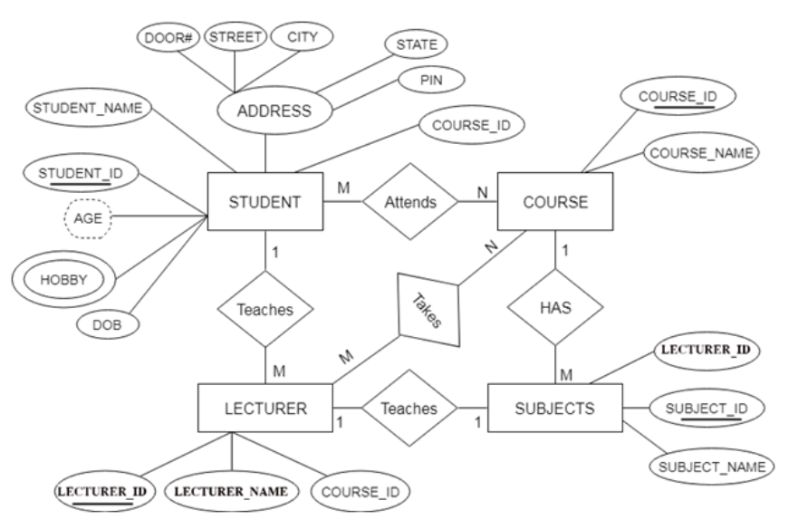

Slide 18
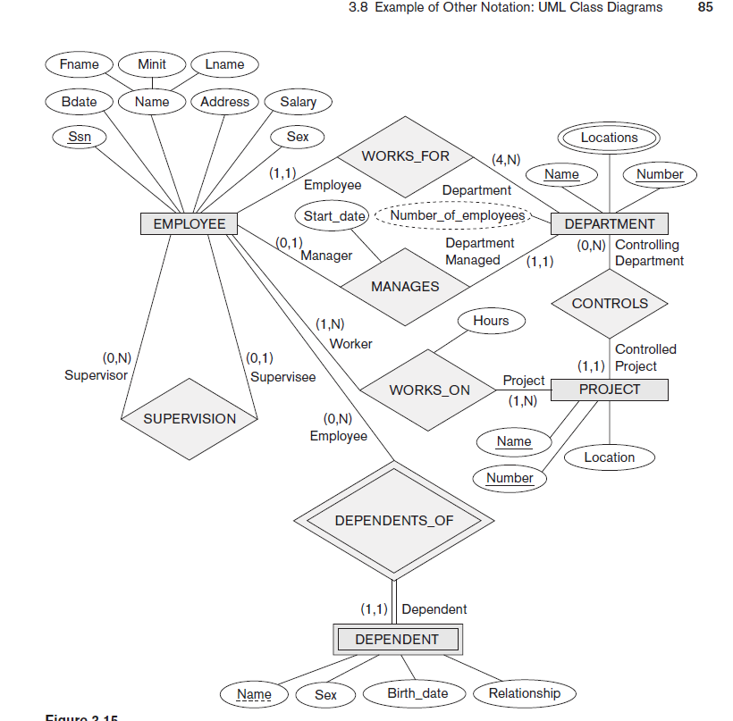

Slide 19
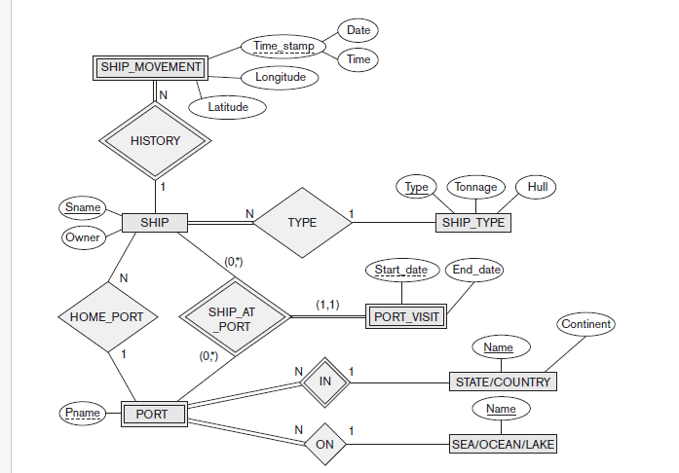

Slide 20
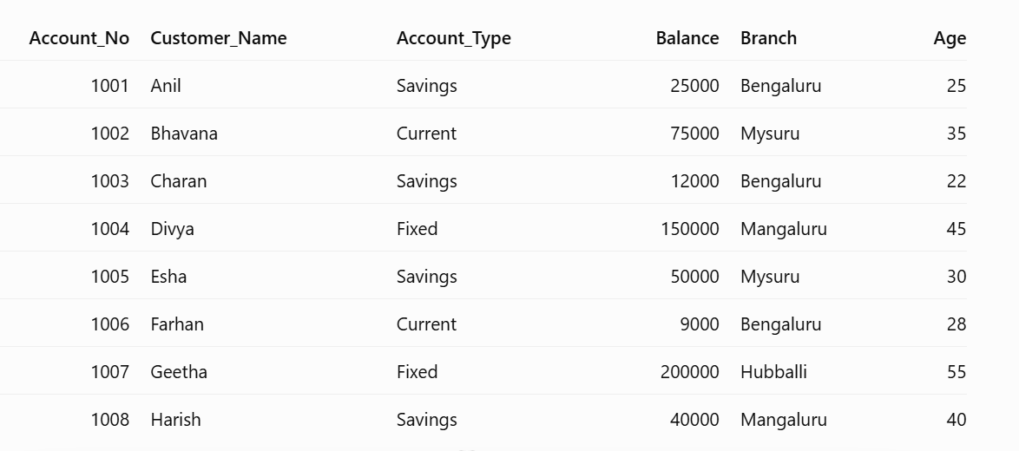

Slide 21
Display the details of customers whose account balance is greater than ₹50,000.
Display the names and balances of customers whose balance is less than or equal to ₹25,000.
Display the details of customers who do not have a savings account.
Display the details of customers who have accounts in Bengaluru, Mysuru, or Mangaluru.
Display the details of customers whose account type is either Savings or Fixed.
Display the details of customers whose account balance is between ₹20,000 and ₹75,000.

Slide 22
Display the details of customers whose age is between 25 and 40
Display the details of customers who have a balance greater than ₹1,00,000 or are older than 50 years.
Display the details of customers who have a Savings account and a balance greater than ₹20,000.
Display the details of customers who do not belong to the Bengaluru branch.
Display the details of Savings account holders whose balance is between ₹20,000 and ₹60,000 and who belong to either Bengaluru or Mysuru.
Display the details of customers who have a Current account or a balance less than ₹15,000, but exclude customers older than 40 years.

Slide 23
Display the details of customers whose names start with the letter 'A’.
Display the details of customers whose names contain the letter 'a’.
Arithmetic operator: Display the account number, customer name, and balance after adding ₹5,000 to each account balance.
DISTINCT: Display all unique account types available in the bank.
ORDER BY: Display customer details in descending order of account balance.

Slide 24
Question: SQL Queries Using a Single Table
Consider the following relation:
BANK_ACCOUNT (Account_No, Customer_Name, Account_Type, Balance, Branch, Age)
Write SQL queries for the following:
a) Display the details of customers whose balance is greater than ₹50,000. (2 Marks)
b) Display the details of customers who have accounts in either Bengaluru or Mysuru using the IN operator. (2 Marks)
c) Retrieve the details of customers whose balance is between ₹20,000 and ₹75,000 using the BETWEEN operator. (2 Marks)
d) Display the names of customers who have a Savings account and a balance greater than ₹25,000 using logical operators. (2 Marks)
e) Display the details of customers whose names start with the letter 'A' using the LIKE operator. (2 Marks)

Slide 25
Topics
Database Characteristics
Advantages of using database
Three Shema Architecture
Database System Environment
Relational Model Concepts
DDL, DML statement syntax

